Slide 1

:: Banking data mining case study
João Miguel Polónia Pascoal Faria
Márcio Filipe Vilela Fontes
Supervisor: Prof. João Pedro Carvalho Leal Mendes Moreira
Mestrado Integrado em Engenharia Informática e Computação
Faculdade de Engenharia da Universidade do Porto
January 6, 2016

Slide 2
#1
CRISP-DM
Notes:
Health Problems (stress, pollution, etc.) -> related with environment
Economic impact
Environmental impact

Slide 3
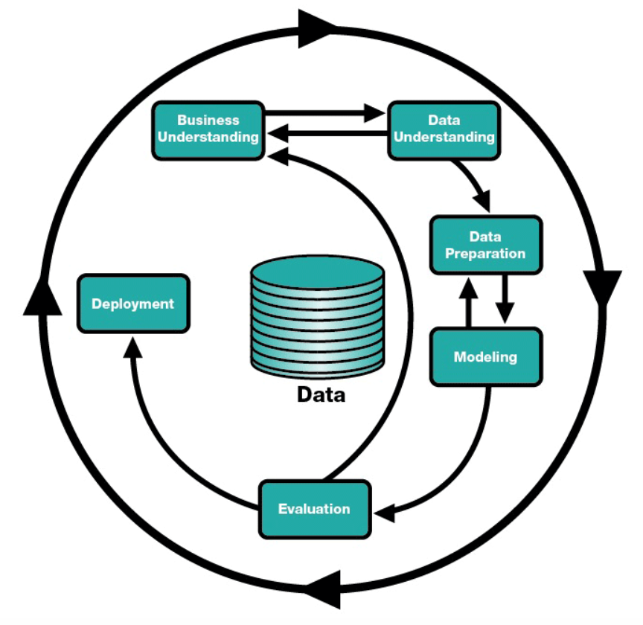
#CDM
CRISP-DM
Notes:
Health Problems (stress, pollution, etc.) -> related with environment
Economic impact
Environmental impact

Slide 4
#2
Domain description
Notes:
Health Problems (stress, pollution, etc.) -> related with environment
Economic impact
Environmental impact

Slide 5
#DD
Domain description
Topic
Data about banking operations of a regular bank, containing information about clients, loans, transactions and credit cards;
There is also demographic data to help understanding the environment;
The bank wants to improve their understanding of customers in order to perform actions and to improve its services.
Descriptive Goals
Study the clients, concerning their loans (amounts and durations), transactions, etc. to formulate a process to achieve the predictive goal;
Study the environment to understand the type of clients the bank should target, the districts where they are located, etc.
Predictive Goal
Determine whether a loan will end successfully.
Notes:
Health Problems (stress, pollution, etc.) -> related with environment
Economic impact
Environmental impact

Slide 6
#3
Exploratory data analysis
Notes:
Health Problems (stress, pollution, etc.) -> related with environment
Economic impact
Environmental impact

Slide 7
#EDA
Data preparation
Extract implicit knowledge
Extract birthdate and gender from birthnumber (Clients relation)
Extract age from birthnumber (note: assume 2016 as current year)
Complete missing values
District Jesenik had missing values (unemployment rate 1996 and crimes in 1996)
These ones were replaced by the median of all other districts
Extract useful information from transactions
Accounts with history of sanctions
Discretization
Use of these of techniques for converting quantitative to qualitative
Notes:
Health Problems (stress, pollution, etc.) -> related with environment
Economic impact
Environmental impact

Slide 8
#4
Descriptive data analysis
Notes:
Health Problems (stress, pollution, etc.) -> related with environment
Economic impact
Environmental impact

Slide 9
#DM
Gender distribution
Notes:
Health Problems (stress, pollution, etc.) -> related with environment
Economic impact
Environmental impact

Slide 10
#DM
Average Salary per District
Notes:
Health Problems (stress, pollution, etc.) -> related with environment
Economic impact
Environmental impact

Slide 11
#DM
Crimes and Unemployment increase
Notes:
Health Problems (stress, pollution, etc.) -> related with environment
Economic impact
Environmental impact

Slide 12
#DM
Clients per Region
Notes:
Health Problems (stress, pollution, etc.) -> related with environment
Economic impact
Environmental impact

Slide 13
#DM
Issuance Frequency
Notes:
Health Problems (stress, pollution, etc.) -> related with environment
Economic impact
Environmental impact

Slide 14
#DM
Credit cards distribution
Notes:
Health Problems (stress, pollution, etc.) -> related with environment
Economic impact
Environmental impact

Slide 15
#DM
Loan amount comparison
Notes:
Health Problems (stress, pollution, etc.) -> related with environment
Economic impact
Environmental impact

Slide 16
#DM
Loan duration distribution
Notes:
Health Problems (stress, pollution, etc.) -> related with environment
Economic impact
Environmental impact

Slide 17
#DM
Client vs. Card Clusters (K-Means)
age | gender | card_type
-1.2302465 | 1 | 2
-0.3775839 | 0.25 | 0.1
-1.2061650 | 0 | 2
1.2849300 | 0.05 | 0.05
0.5920177 | 1 | 0.02777778
Notes:
Health Problems (stress, pollution, etc.) -> related with environment
Economic impact
Environmental impact

Slide 18
#DM
Client vs. Demography Clusters (K-Means)
age | inhabitants | ...
-0.011794711 | 2.1745980 | ...
0.008867357 | -0.1410296 | ...
0.054998006 | -0.3218908 | ...
-0.025915663 | -0.4892006 | ...
Notes:
Health Problems (stress, pollution, etc.) -> related with environment
Economic impact
Environmental impact

Slide 19
#DM
Client vs. Insurances Clusters (K-Means)
amount | n_entrepreneurs | crimes_96
0.6656325 | 1.8903740 | 2.4398930
0.4066814 | -0.7176040 | -0.4633185
-0.4444360 | 0.1075921 | -0.4689837
-0.1039707 | -0.6054897 | -0.2008185
Notes:
Health Problems (stress, pollution, etc.) -> related with environment
Economic impact
Environmental impact

Slide 20
#5
Predictive data analysis
Notes:
Health Problems (stress, pollution, etc.) -> related with environment
Economic impact
Environmental impact

Slide 21
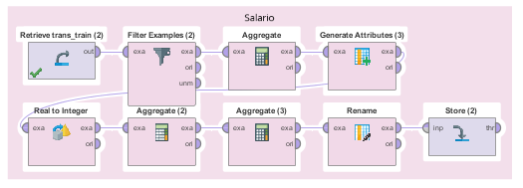
#PM
Data Preparation
Monthly Revenue
Aggregation of the monthly income per account. Used instead of the District average salary because it is a more personal indicator.
Notes:
Health Problems (stress, pollution, etc.) -> related with environment
Economic impact
Environmental impact

Slide 22
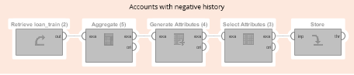
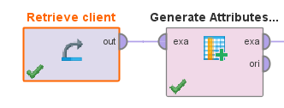
#PM
Data Preparation
Reputation
Aggregation of the history of an account based on its past loans.
The values can be “good”, “bad” or “neutral” according with the status of the loans.
This is calculated using only the train data with fixed rand seed.
Age
Contains the age of the client based on its birth number.
Notes:
Health Problems (stress, pollution, etc.) -> related with environment
Economic impact
Environmental impact

Slide 23
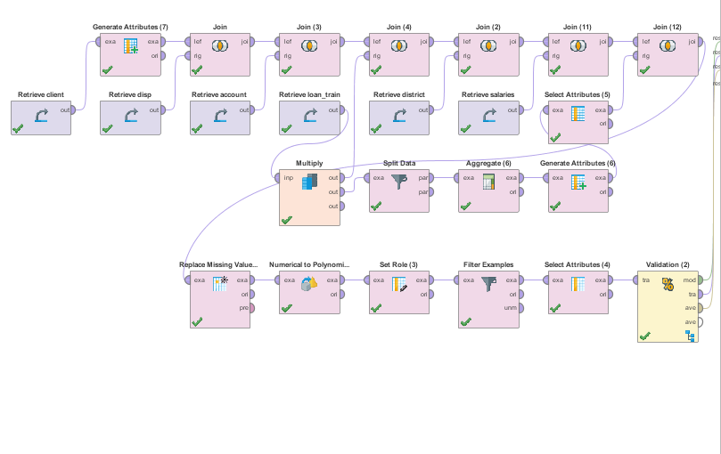
#PM
Data Preparation
Operations
Almost all of the cases use this scenario and vary only inside Split Validation.
Both the Split Validation and the Split Data use 70% for training, 30% for testing, and use the same seed for separation.
Notes:
Health Problems (stress, pollution, etc.) -> related with environment
Economic impact
Environmental impact

Slide 24
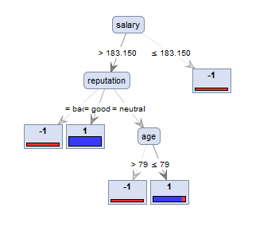
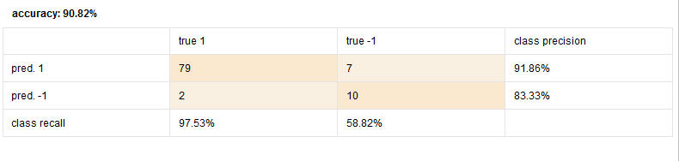
#PM
Decision Tree
Decision tree
As we can see in the images, the salary, the reputation and the age were the best attributes to predict successful loans.
The results in the Decision Tree are good, but they are very sensitive to new accounts without any history on loans.
Notes:
Health Problems (stress, pollution, etc.) -> related with environment
Economic impact
Environmental impact

Slide 25
#PM
Decision Tree
Decision Tree Parameters
Criterion: gain_ratio
Apply pruning
Confidence: 25%
Apply prepruning
Minimal gain: 10%
Minimal leaf size: 2
Minimal size for split: 4
Number of perpruning alternatives: 3
Notes:
Health Problems (stress, pollution, etc.) -> related with environment
Economic impact
Environmental impact

Slide 26
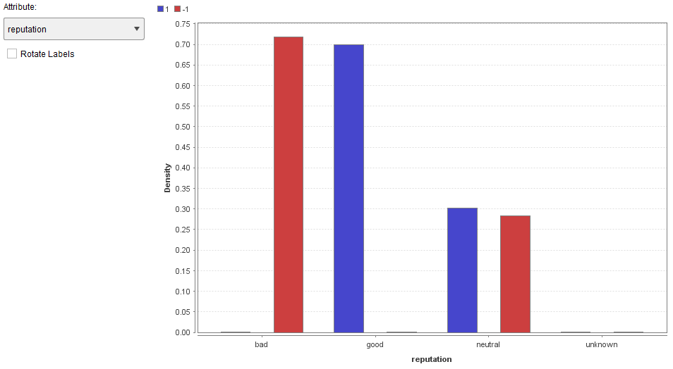
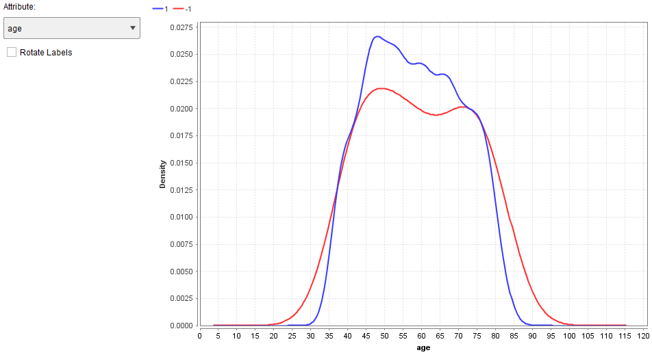
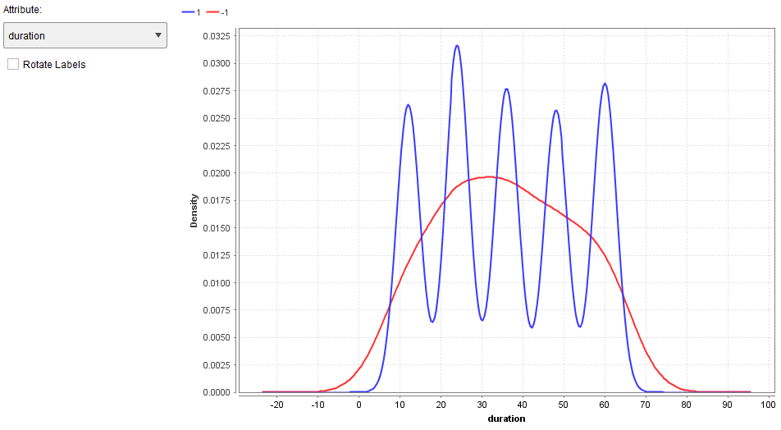
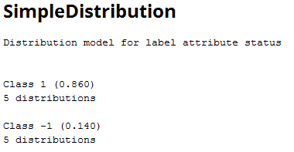
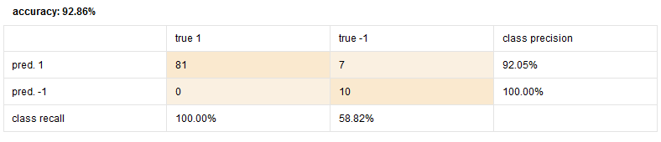
#PM
Naive Bayes
Naive Bayes
We used a subset of the data for this case which lead to a improvement in the accuracy. It uses the age, the salary, the reputation, the loan amount and the loan duration.
As we can see in the graph, the reputation is a really good indicator of successful loan and the age can be used to filter below 30 and above 85.
The duration gives a good information for the bank on which durations loans should be for higher success.
Overall the results are also good.
Notes:
Health Problems (stress, pollution, etc.) -> related with environment
Economic impact
Environmental impact

Slide 27
#PM
Naive Bayes
Naive Bayes (Kernel) Parameters
Laplace correction
Estimation mode: full
Bandwidth selection: heuristic
Notes:
Health Problems (stress, pollution, etc.) -> related with environment
Economic impact
Environmental impact

Slide 28
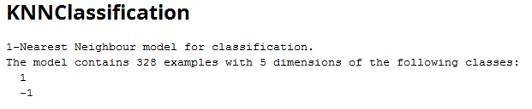
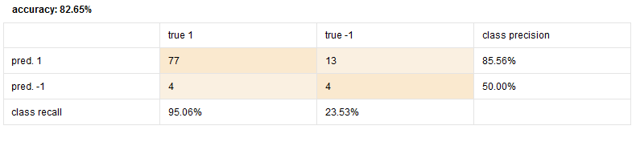
#PM
K-NN
K-NN
We also opted for the subset of parameters in the k-NN for improved accuracy. This method had the lowest of the scores, both for class precision and recall.
Notes:
Health Problems (stress, pollution, etc.) -> related with environment
Economic impact
Environmental impact

Slide 29
#PM
K-NN
K-NN Parameters
K: 1
Measure types: MixedMeasures
Mixed measure: MixedElucideanDistance
Notes:
Health Problems (stress, pollution, etc.) -> related with environment
Economic impact
Environmental impact

Slide 30
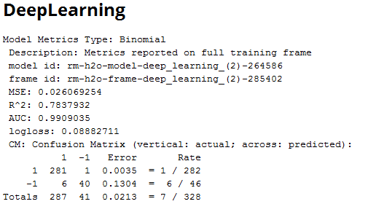
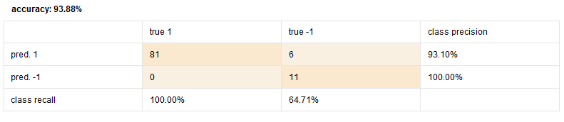
#PM
Deep Learning
Deep Learning
Once again we opted for a subset for increased accuracy.
This method was also good in relation to the attributes we passed.
Notes:
Health Problems (stress, pollution, etc.) -> related with environment
Economic impact
Environmental impact

Slide 31
#PM
Deep Learning
Deep Learning Parameters
Activation: Maxout
Hidden layer sizes: 50 50
Epochs: 10
Train samples per iteration: -2
Adaptive rate
Epsilon: 1.0E-8
Rho: 0.99
Standardize
(defaults)
Notes:
Health Problems (stress, pollution, etc.) -> related with environment
Economic impact
Environmental impact

Slide 32
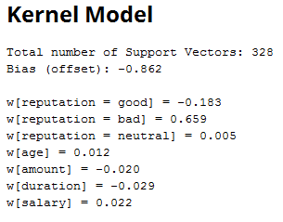
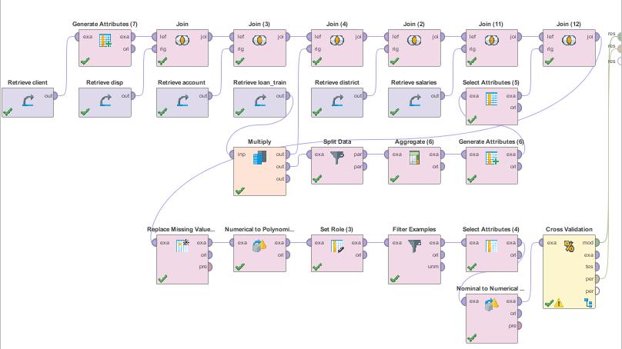
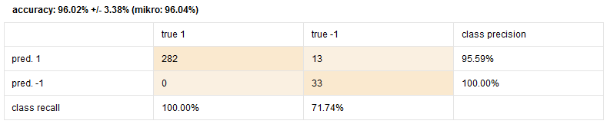
#PM
SVM
Support Vector Machine
Due to the nature of the SVM, we had to convert the attributes to Numerical.
We used Cross validation for the SVM, which led to higher results than any of the other methods.
Notes:
Health Problems (stress, pollution, etc.) -> related with environment
Economic impact
Environmental impact

Slide 33
#PM
SVM
SVM Parameters
Kernel type: polynomial
Convergence epsilon: 0.01
(defaults)
Notes:
Health Problems (stress, pollution, etc.) -> related with environment
Economic impact
Environmental impact

Slide 34
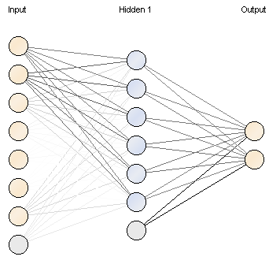
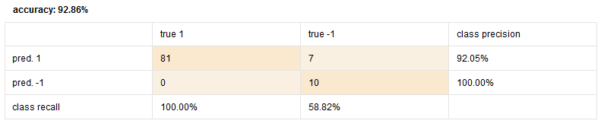
#PM
Neural Net
Support Vector Machine
Due to the nature of the NN, we had to convert the attributes to Numerical.
We used Split Validation and subset of attributes, hence the “low” result in comparison to what was supposed from a NN.
The result using all the attributes and Cross Validation is very similar to SVM, but takes significantly higher time to compute.
Notes:
Health Problems (stress, pollution, etc.) -> related with environment
Economic impact
Environmental impact

Slide 35
#PM
Neural Net
Neural Net Parameters
Decay
(defaults)
Notes:
Health Problems (stress, pollution, etc.) -> related with environment
Economic impact
Environmental impact

Slide 36
#6
Limitations and Future Work
Notes:
Health Problems (stress, pollution, etc.) -> related with environment
Economic impact
Environmental impact

Slide 37
#LFW
Limitations and Future Work
Limitations
The data is very old, so the potential applications of the predictions may not be useful;
If more data about the environment was gathered, better decisions could be taken (i.e. instead of having the average salary of a district, it would be more useful to have also the client’s salary);
There is a huge gap of instances between the successful and failed loans on the training spreadsheet.
Future Work
Perform a refinement of the algorithms used with real tests;
Use regression techniques to complement the Descriptive Modeling;
Test different and new prediction methods.
Notes:
Health Problems (stress, pollution, etc.) -> related with environment
Economic impact
Environmental impact

Slide 38
#7
Conclusions
Notes:
Health Problems (stress, pollution, etc.) -> related with environment
Economic impact
Environmental impact

Slide 39
#CC
Conclusions
It was possible to identify that the loan amount has a significant impact on the loan success;
It was possible to prove that the environment (scenarios of unemployment, high crime rate, etc.) of each client has significant impact on the insurance payments;
It was possible to find that the classic card owners are usually male and older people (this helps to focus on specific type of ads);
It was possible to conclude that the bank should target South Bohemia in order to get more clients;
It is suggested that the bank should “help” the clients which are unemployed with their loans, by reducing taxes for example, if the unemployment increase from 95-96 shall continue.
Notes:
Health Problems (stress, pollution, etc.) -> related with environment
Economic impact
Environmental impact

Slide 40
Notes:
Health Problems (stress, pollution, etc.) -> related with environment
Economic impact
Environmental impact

Slide 41
#8
Annexes
Notes:
Health Problems (stress, pollution, etc.) -> related with environment
Economic impact
Environmental impact

Slide 42
#AN
Data preparation
Disposition
Credit card (sanctions)
disp_id | client_id | account_id | type
1 | 1 | 1 | OWNER
2 | 2 | 2 | OWNER
3 | 3 | 2 | DISPONENT
card_id | disp_id | client_id | type | issued | account_id
117 | 649 | 649 | junior | 961123 | 539
786 | 5478 | 5478 | classic | 961231 | 4543
1164 | 12269 | 12577 | classic | 960812 | 10227
Account
Payment Orders
account_id | district_id | frequency | date
576 | 55 | monthly issuance | 930101
3818 | 74 | monthly issuance | 930101
704 | 55 | monthly issuance | 930101
order_id | account_src | date | bank | account_dst | amount | k_symbol
1 | 2 | 931105 | QR | 13943797 | 7266 | household
2 | 2 | 930905 | QR | 13943797 | 7266 | household
3 | 2 | 931205 | QR | 13943797 | 7266 | household
Notes:
Health Problems (stress, pollution, etc.) -> related with environment
Economic impact
Environmental impact

Slide 43
#AN
Data preparation
District
code | name | region | ratio_urban_inhabitants | unemployment_95 | unemployment_96 | crimes_95 | crimes_96
1 | Hl.m. Praha | Prague | 100 | 0.29 | 0.43 | 85677 | 99107
2 | Benesov | Central Bohemia | 46.7 | 1.57 | 1.85 | 2159 | 2674
3 | Beroun | Central Bohemia | 41.7 | 1.95 | 2.21 | 2824 | 2813
Client
client_id | birth_number | district_id | year | month | day | gender
1 | 706213 | 18 | 1970 | 12 | 13 | f
2 | 450204 | 1 | 1945 | 02 | 04 | m
3 | 406009 | 1 | 1940 | 10 | 09 | f
Notes:
Health Problems (stress, pollution, etc.) -> related with environment
Economic impact
Environmental impact

Slide 44
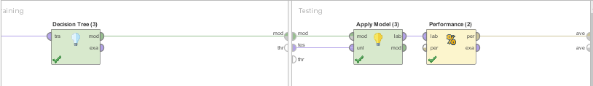
#AN
Decision Tree process (RapidMiner)
Notes:
Health Problems (stress, pollution, etc.) -> related with environment
Economic impact
Environmental impact

Slide 45
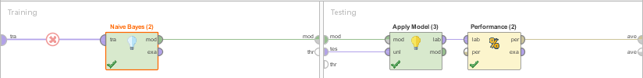
#AN
Naive Bayes process (RapidMiner)
Notes:
Health Problems (stress, pollution, etc.) -> related with environment
Economic impact
Environmental impact

Slide 46
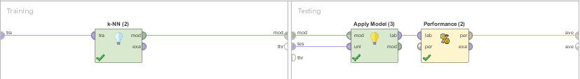
#AN
K-NN process (RapidMiner)
Notes:
Health Problems (stress, pollution, etc.) -> related with environment
Economic impact
Environmental impact

Slide 47
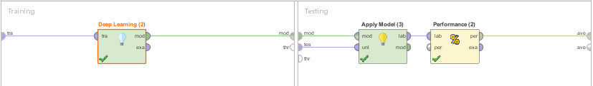
#AN
Deep Learning process (RapidMiner)
Notes:
Health Problems (stress, pollution, etc.) -> related with environment
Economic impact
Environmental impact

Slide 48
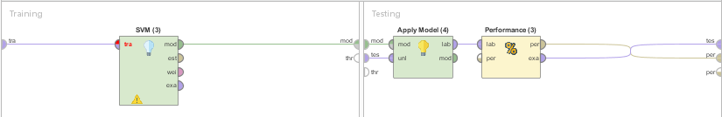
#AN
SVM process (RapidMiner)
Notes:
Health Problems (stress, pollution, etc.) -> related with environment
Economic impact
Environmental impact

Slide 49
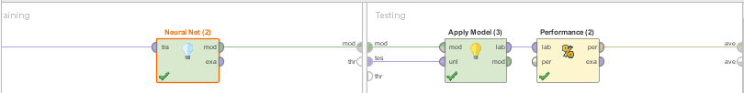
#AN
NN process (RapidMiner)
Notes:
Health Problems (stress, pollution, etc.) -> related with environment
Economic impact
Environmental impact

